Slide 1
Predictive Analytics and Quality Control in Healthcare
Daniel Griffith and Eduardo Santiago

Slide 2
Table of Contents
What is and Why Predictive Analytics?
Difficulties arising from the application of predictive analytics
Predictive Analytic Tools
Quality Control

Slide 3
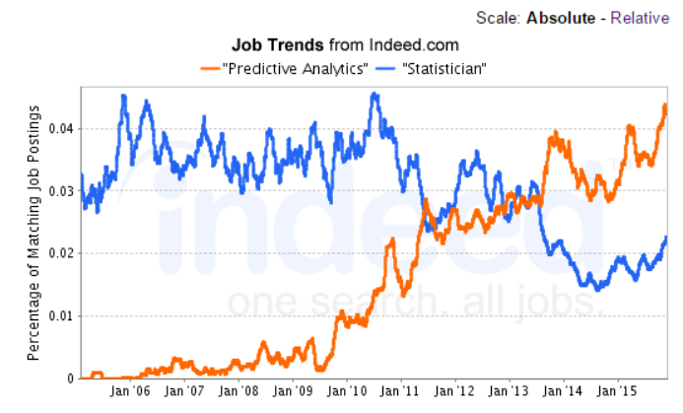
What is and Why Predictive Analytics
Predictive Analytics is the use of information systems, statistics, and/or computer-based models to help decision makers analyze historical data to make predictions about the future.
Dramatic growth of applications of analytics. Source: indeed.com

Slide 4

What is and Why Predictive Analytics
As indicated by Eric Siegl’s book the application of predictive analytics lies in the power to predict who will click, buy, lie or die.

Slide 5
Difficulties arising from its application
Evans [1] suggests that organizations are overwhelmed by data and have difficulty determining how to use it.
Successful application of analytics requires the integration of data, statistics, and Operations Research. But most importantly it requires a high-level understanding of how analytics supports an organization’s competitive strategy.

Slide 6
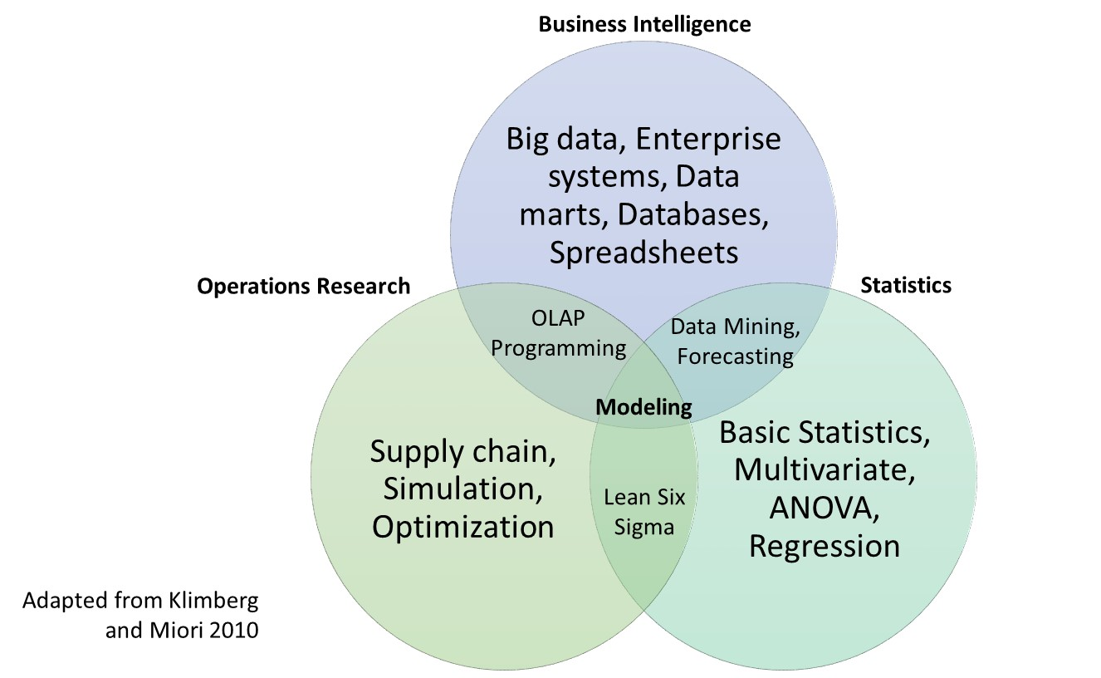
Analytics Framework

Slide 7
Predictive Analytic Tools
Principal Components Analysis
Partial Least Squares
Cross Validation Techniques
Binary Logistic Regression
Risk-adjusted Monitoring Charts
Rare Events Charts (and not so “rare”)

Slide 8
Principal Component Analysis
How to analyze many variables that could be highly correlated with each other?
How to identify the underlying relationships that could exist between these correlated variables?
How to combine these variables to extract the essence of the data?

Slide 9
Principal Component Analysis
Let’s talk about the great Bob Ross.

Slide 10
Principal Component Analysis
FiveThirtyEight published an article in 2014 on “A Statistical Analysis of the Work of Bob Ross”
Notes:
The Joy of Painting featured 403 episodes over the span of 11 years.

Slide 11
Predictive Analytic Tools
Principal Components Analysis
Partial Least Squares
Cross Validation Techniques
Binary Logistic Regression
Risk-adjusted Monitoring Charts
Rare Events Charts (and not so “rare”)

Slide 12
Partial Least Squares – Readmission Diabetes
130 hospitals in the US from 1999-2008, patients with diabetes.
55 attributes from over 100,000 patients.
The data contains such attributes as patient number, race, gender, age, admission type, time in hospital, medical specialty of admitting physician, number of lab tests performed, HbA1c test result, diagnosis, number of medications, diabetic medications, number of outpatient, inpatient, and emergency visits in the year before the hospitalization, etc.

Slide 13
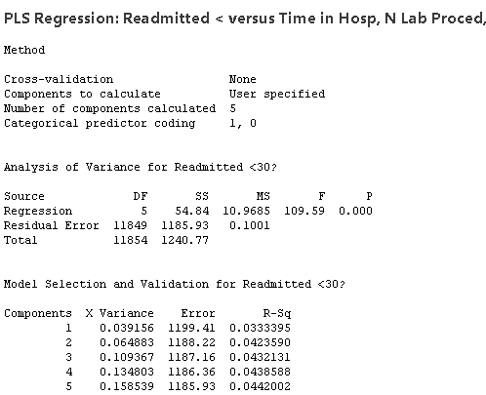
Partial Least Squares – Readmission Diabetes
Binary logistic regression could be used but…

Slide 14
Partial Least Squares – Readmission Diabetes
Comparable results are obtained in terms of prediction but in a less painful way.

Slide 15
Predictive Analytic Tools
Principal Components Analysis
Partial Least Squares
Cross Validation Techniques
Binary Logistic Regression
Risk-adjusted Monitoring Charts
Rare Events Charts (and not so “rare”)

Slide 16
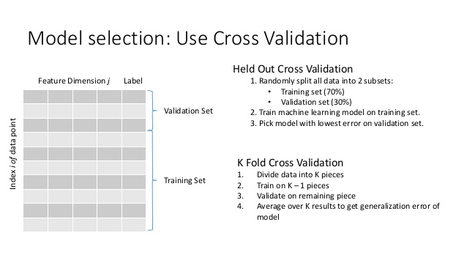
Partial Least Squares – Readmission Diabetes
Using all data to fit a predictive model can result in overfitting.
Cross Validation is a technique commonly used to ensure the predictive model can do its job.

Slide 17
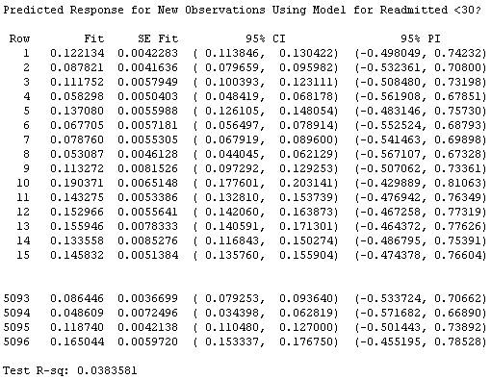
Partial Least Squares – Readmission Diabetes
Cross Validation results are displayed:
.
.
.
.
.
.
.
.
.
.
.
.
.
.
.

Slide 18
Partial Least Squares – Readmission Diabetes
Another way to assess the model is to look at the correct classification of patients in a confusion matrix.
 | Prediction according to model
Observed Outcome | Not likely to be readmitted | Likely to be readmitted
No readmission | 4076 | 427
Readmission | 455 | 138
Model classification = 83%
A natural follow-up would be to investigate what factors can be used to more accurately predict this group.

Slide 19
Predictive Analytic Tools
Principal Components Analysis
Partial Least Squares
Cross Validation Techniques
Binary Logistic Regression
Risk-adjusted Monitoring Charts
Rare Events Charts (and not so “rare”)

Slide 20
Assessing the level of pre-operative risk for cardiac surgery patients
There is considerable variation in the level of risk
There are multiple variables that can be used to evaluate this risk: age, gender, hypertension, diabetic status, renal function, and left ventricular mass
The Parsonnet score summarizes this in a single number
To illustrate we use the data from Steiner et al. [3] that includes 6,994 patients and whether or not they died within 30 days of surgery.

Slide 21
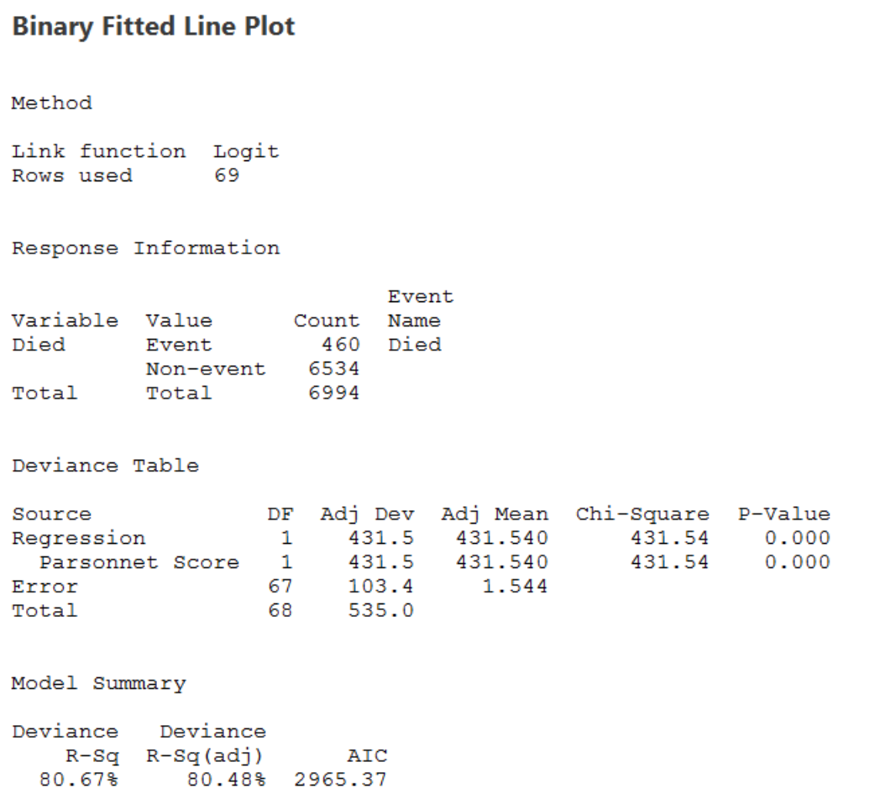
Build Predictive Model: Binary Logistic
A very simple model can be built based on a patient’s Parsonnet’s score.

Slide 22
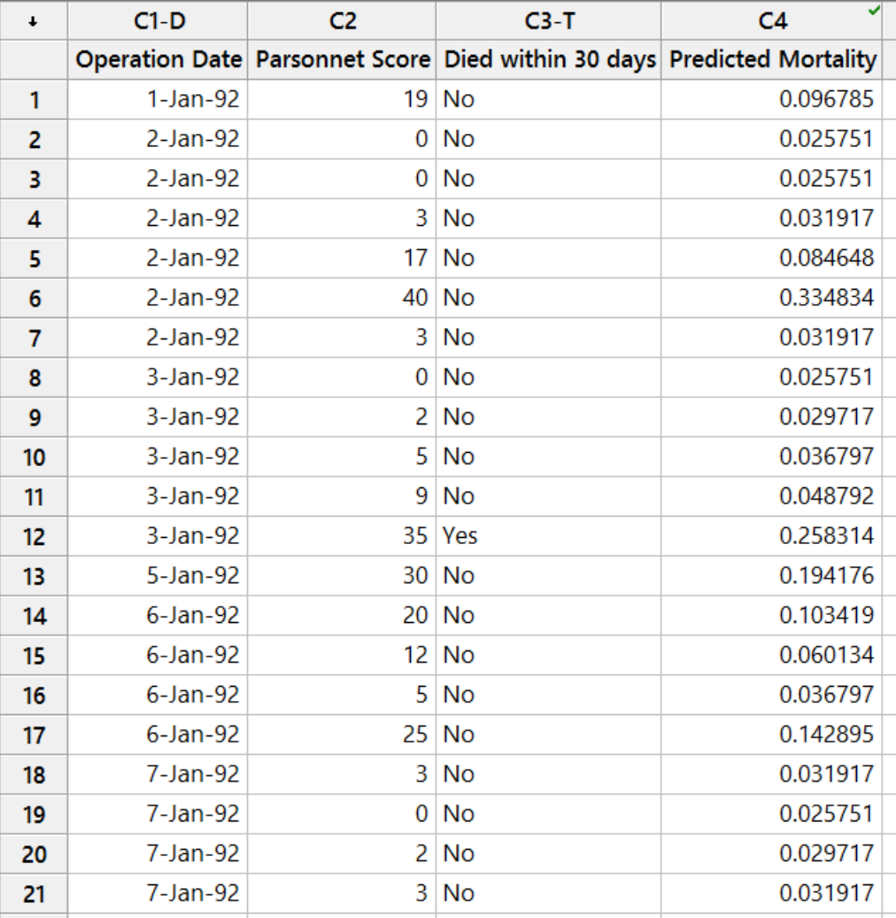
Build Predictive Model: Binary Logistic
Using Parsonnet’s Score we can assign the Predicted Mortality to each patient.

Slide 23
Predictive Analytic Tools
Principal Components Analysis
Partial Least Squares
Cross Validation Techniques
Binary Logistic Regression
Risk-adjusted Monitoring Charts
Rare Events Charts (and not so “rare”)

Slide 24
How should we Monitor Mortality Rate?
We have a Binary Outcome
We have the Operation Date Recorded
We have the risk of Mortality associated with each Patient

Slide 25
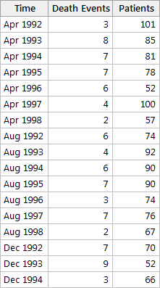
Monitoring the Mortality Rate

Slide 26
Monitoring the Mortality Rate
Only one month the probability is considered to be out of control.

Slide 27
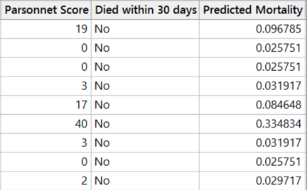
Monitoring the Mortality Rate
We are assuming each patient has the same risk of Mortality going into his/her surgery.
What is wrong with the P-Chart approach?

Slide 28
Monitoring the Mortality Rate
So what type of chart do we need?
We need to account for the different patient risk level for the plotted points
We need to have proper detection when the mortality rate is increasing while ensuring we adjust for the proper risk level.
Therefore, we need control limits based on the varying risk levels of the patients.
We need to monitor mortality with:
Risk Adjusted Bernoulli CUSUM with Dynamic Probability Control Limits

Slide 29
Risk-adjusted Charts

Slide 30
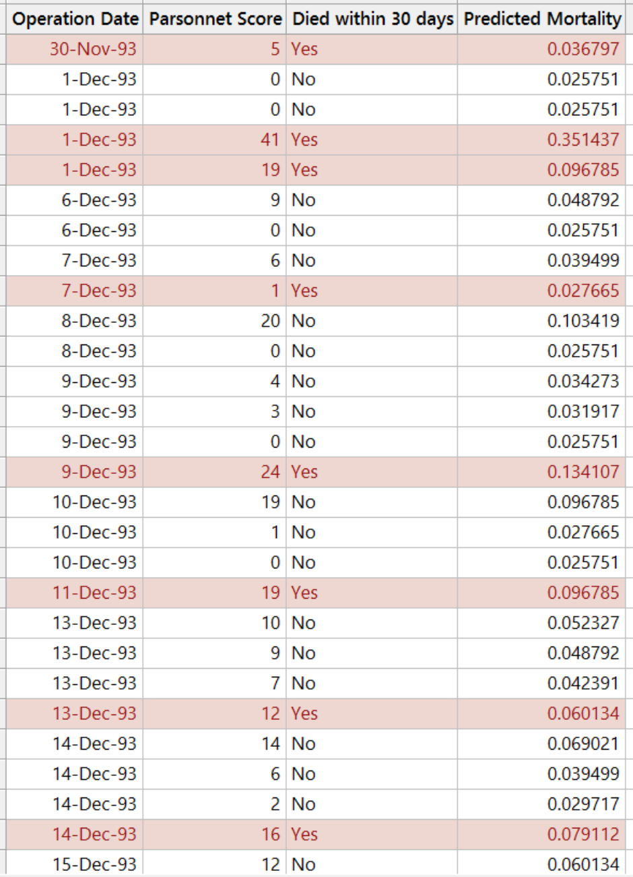
Risk-adjusted Charts

Slide 31
Predictive Analytic Tools
Principal Components Analysis
Partial Least Squares
Cross-validation Techniques
Binary Logistic Regression
Risk-adjusted Monitoring Charts
Rare Events Charts (and not so “rare”)

Slide 32
Monitoring Rare Events – UTI’s
Description: A large hospital system concerned with a very high rate of hospital-acquired urinary tract infections (UTIs) is trying to evaluate if their processes are in statistical control.
Because the root cause often differs based on gender, male and female patients are charted separately.
The financial cost to the hospital is significant, with Medicare no longer covering the cost to treat hospital-acquired infections (historically 80% coverage).

Slide 33
Monitoring Rare Events – UTI’s

Slide 34
Conclusions
With the increasing size of datasets, predictive analytics should be part of LSS professionals toolset
Classification problems in Healthcare include modeling readmissions, or mortality but can be generalized to handle problems from various disciplines
Binary logistic regression, Partial Least Squares are two popular modeling techniques that can incorporate cross validation to ensure robust models
Process monitoring is a difficult task to achieve when the “samples” are not homogeneous

Slide 35
References
Evans, J.R. Modern Analytics and the Future of Quality and Performance Excellence. QMJ, Vol. 22, No. 4, 2015. Pp 6-17.
Klimberg, R. K, and V. Miori. 2010. Back in business. OR/MS Today 375:22–27.
Steiner, S.H., Cook, R.J., Farewell, V.T., Treasure, T. Monitoring surgical performance using risk-adjusted cumulative sum charts. Biostatistics (2000), 1, 4, pp. 441-452.
Hickey, W. A Statistical Analysis of the Work of Bob Ross. Apr 14, 2014. http://fivethirtyeight.com/features/a-statistical-analysis-of-the-work-of-bob-ross/
https://archive.ics.uci.edu/ml/datasets/Diabetes+130-US+hospitals+for+years+1999-2008
Zhang, X., Woodall, W.H. “Dynamic probability control limits for risk-adjusted Bernoulli CUSUM charts.” Statistics in Medicine, Volume 34, Issue 25, Pp 3336-3348.
Santiago, E., and Smith, J., 2013, “Control Charts Based on the Exponential Distribution: Adapting Runs Rules for the t Chart,” Journal of Quality Engineering, 25, 85-96.

